Slide 1
MUSIC RECOMMENDATION SYSTEM
RNS INSTITUTE OF TECHNOLOGY
BENGALURU - 98
DEPARTMENT OF INFORMATION SCIENCE & ENGINEERING
Presentation on Internship
ANAGHA MH
USN: 1RN19IS025
MB BHAVANA
USN: 1RN19IS082

Slide 2
AGENDA
Abstract
About the Company
Introduction
Literature Survey
Requirements
System Design
Detailed Design
Implementation
Results
Conclusion and Future Enhancements
References
Q & A

Slide 3
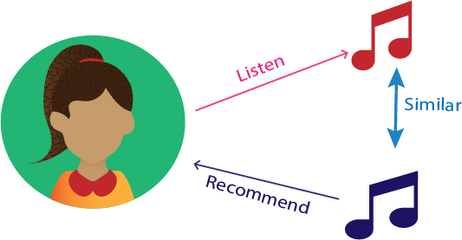
ABSTRACT
We analysed, processed the dataset and implemented a song recommendation system for this project. We used Kaggle's Spotify Song Dataset to generate recommendations for songs that users would like to listen to the most. The user can pick a song from the database and search for recommendations that are most likely connected to it. We utilised the cosine similarity method to assess each song based on genre, artist name, duration, danceability, and other factors. It builds a playlist for the user based on the calculations. The recommendations can be generated using a variety of techniques.

Slide 4
ABOUT THE COMPANY
NASTECH – New Age Solutions & Technologies
NASTECH is formed with the purpose of bridging the gap between Academia and Industry.
Nastech is one of the leading Global Certification and Training service providers for technical and management programs for educational institutions.
They collaborate with educational institutes to understand their requirements and form a strategy in consultation with all stakeholders to fulfill those by skilling , reskilling and upskilling the students and faculties on new age skills and technologies.
Industry and project oriented student training programs.
Certification programs mapped to Global Certification Exams from Microsoft/EC- Council/Google/AWS/ Adobe).

Slide 5
INTRODUCTION
Music recommender system is a system which learns the users liking of the music based on the genres such as hip-hop, classical, R&B, instrumental, etc. And various factors like danceability, acousticness, instrumentalness, valence, tempo, energy, etc.
we have used cosine similarity algorithm which is simple and intuitive.
Cosine similarity is a metric used to measure the similarity of two vectors. Specifically it measure the similarity in direction or orientation of two vectors ignoring differences in their magnitude and scale.
Currently, there are many music streaming services, like Pandora, Spotify, etc. which are working on building high-precision commercial music recommendation systems. These companies generate revenue by helping their customers discover relevant music and charging them for the quality of their recommendation service.
Thus, there is a strong thriving market for good music recommendation systems.

Slide 6
LITERATURE SURVEY
In the second quarter of 2021, the number of music streaming subscribers worldwide amounted to 523.9 million, up from just under 487 million at the end of the first quarter of 2021. Paid music streaming subscriptions have become the norm for many music fans, and the market has seen consistently impressive increases in subscriber numbers over the last few years.
Recent forecasts show however that whilst both subscriber numbers and revenue are expected to continue to rise, growth will slow down in the near future. Changes can already be seen from 2016 onwards.
Year-on-year music streaming revenue growth was 65.1 percent worldwide, but fell by more than 20 percent in 2017 and was just 34 percent a year later.

Slide 7
LITERATURE SURVEY
It is expected that the U.S. and the UK will continue to be the biggest streaming markets in years to come, but reports also show that Brazil, India, China, and MENA countries will catch up over the next decade and rank among the top global markets by 2026.
Other changes to the market include a growing focus on podcasts, which have more potential than many music buffs may realize.
A 2019 report showed that podcast curators with an average audience of 20 thousand listeners per weekly podcast would need just 80 thousand streams per month to generate an income of around 6,500 U.S. dollars. Meanwhile, major record label artists would need over seven million streams of their content to earn the same amount.

Slide 8
REQUIREMENTS
HARDWARE REQUIREMENTS
Processor : Any Processor above 500 MHz
RAM : 512Mb
Hard Disk : 4 GB
Input device : Standard Keyboard and Mouse
Output device : VGA and High Resolution Monitor
SOFTWARE REQUIREMENTS
Operating system : Windows 10
IDE : Kaggle Notebook, google collab
Tools/Technologies : Python

Slide 9
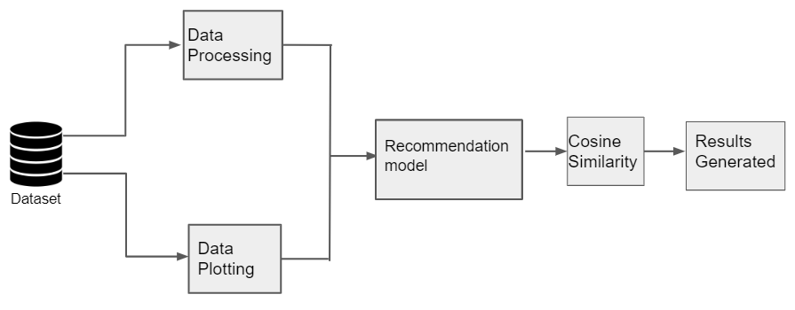
SYSTEM DESIGN
As depicted in the figure, first the data in the dataset has been processed, analysed and implemented.
Then the mapping for the data has been done based on the duration, loudness, key, energy, danceability, acousticness, genre, etc.
This processed data is then fed into the recommendation model which was designed using the cosine similarity model.
It takes the song name and the number of recommendations needed as the input from the user.
From each music that is fetched it gives the closest recommendation for the input song name based on genre, artist name etc.

Slide 10
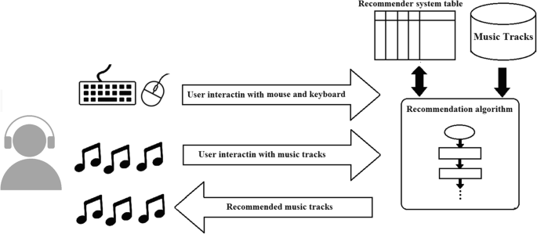
DETAILED DESIGN
DATA PROCESSING : We have utilized the Spotify Song dataset provided by Kaggle which contains thousands of songs. We have analysed, processed this dataset and built the recommendation system. There are various factors we have considered in building the system like genres such as hip-hop, classical, R&B, etc. Tempo, danceability, acousticness, instrumental-ness etc is also considered in the process. We have also plotted the analysed data in a pair-plot graph, based on the duration of the song and the HeatMap graph.
COSINE SIMILARITY : Cosine similarity is a metric used to measure the similarity of two vectors. Specifically, it measures the similarity in the direction or orientation of the vectors ignoring differences in their magnitude or scale.
RECOMMENDATION SYSTEM : Using the cosine similarity algorithm the results for recommendation model will be generated. Here it asks for the user to input the song which is in the dataset and asks for number of recommendations they need. It then loads the data into the model and then displays a list of songs that are more likely related to the input song by the user.

Slide 11
IMPLEMENTATION
Data Processing
Importing The Data
data=pd.read_csv('../input/dataset-of-songs-in-spotify/genres_v2.csv')
Having First Look At The Data
The full list of genres included in the CSV are Trap, Techno, Techhouse, Trance, Psytrance, Dark Trap, DnB (drums and bass), Hardstyle, Underground Rap, Trap Metal, Emo, Rap, RnB, Pop and Hiphop.
Creating a new dataframe with required features
df=data[data.columns[:11]]
df['genre']=data['genre']
df['time_signature']=data['time_signature']
df['duration_ms']=data['duration_ms']
df['song_name']=data['song_name']
x=df[df.drop(columns=['song_name','genre']).columns].values
scaler = StandardScaler().fit(x)
X_scaled = scaler.transform(x)
df[df.drop(columns=['song_name','genre']).columns]=X_scaled

Slide 12
IMPLEMENTATION
Evaluation of the model using COSINE SIMILARITY
def make_matrix_cosine(data,song,number):
df=pd.DataFrame()
data.drop_duplicates(inplace=True)
songs=data['song_name'].values
# best = difflib.get_close_matches(song,songs,1)[0]
best=find_word(song,songs)
print('The song closest to your search is :',best)
genre=data[data['song_name']==best]['genre'].values[0]
df=data[data['genre']==genre]
x=df[df['song_name']==best].drop(columns=['genre','song_name']).values
if len(x)>1:
x=x[1]
song_names=df['song_name'].values
df.drop(columns=['genre','song_name'],inplace=True)
df=df.fillna(df.mean())
p=[]
count=0
for i in df.values:
p.append([distance.cosine(x,i),count])
count+=1
p.sort()
for i in range(1,number+1):
print(song_names[p[i][1]])
c=input('Please enter The name of the song :')
d=int(input('Please enter the number of recommendations you want: '))
make_matrix_cosine(df,c,d)

Slide 13
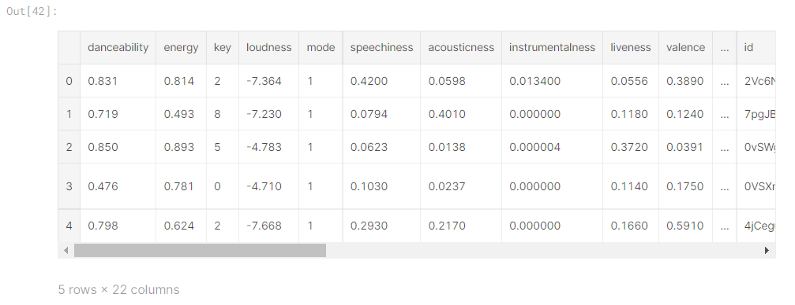
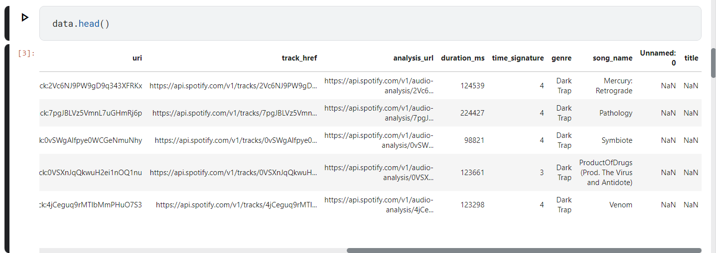
RESULTS

Slide 14
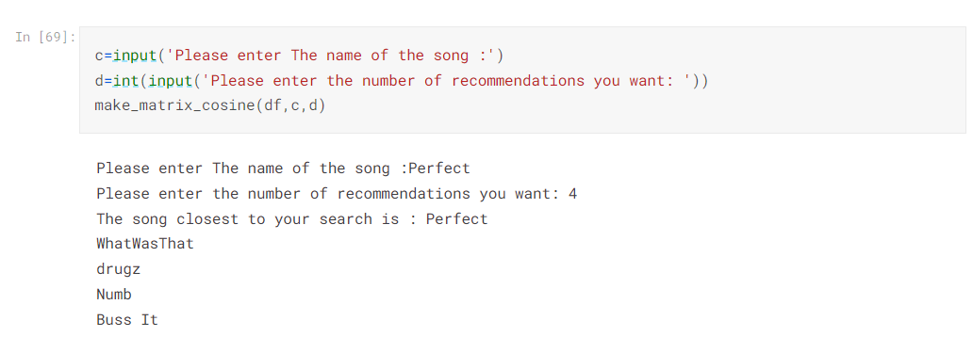
RESULTS

Slide 15
CONCLUSIONS
This is a project of our Artificial Intelligence course. We find it is very good as we got a chance to practice theories that we have learnt in the course, to do some implementation and to try to get a better understanding of a real artificial intelligence problem: Music Recommender System. There are many different approaches to this problem and we get to know some algorithms in detail and especially the cosine similarity algorithm which was very simple and intuitive in this project. By manipulating the dataset, changing the learning set and testing set, changing some parameters of the problem and analyzing the result, we earn a lot practicing skills. We've faced a lot of problem in dealing with this huge dataset, how to explore it in a better way and we also had difficulties in some programming details. However, with lot of efforts, we have overcame all of these.
We hope that we will get other opportunities in the future to work in the domain of artificial intelligence. We are certain that we can do a better job.

Slide 16
LIMITATIONS
Cosine similarity works best when there are many(like sparsely populated) features to choose from rather than with less features.
One main disadvantage of cosine similarity is that the magnitude of the vectors not taken into account, merely their direction.

Slide 17
FUTURE ENHANCEMENTS
To make the system even more efficient and user-friendly, Deep Learning tools can be included. This will enhance the overall efficiency of the recommendation system based on user’s emotions and other factors.. Various other machine learning algorithms can also be used apart from cosine similarity algorithm to improve the accuracy of the model.
Run the algorithms on a distributed system, like Hadoop or Condor, to parallelize the computation, decrease the runtime and leverage distributed memory to run the complete MSD.
Combine different methods and learn the weightage for each method according to the dataset .
Develop more recommendation algorithms based on different data (e.g. the how the user is feeling, social recommendation, etc).

Slide 18
REFERENCES
Wikipedia
Kaggle, github for datasets
Quora questions and answer
Stack overflow for resolving errors
Other external links

Slide 19
Question and Answer

Slide 20
THANK YOU

